Slide 1
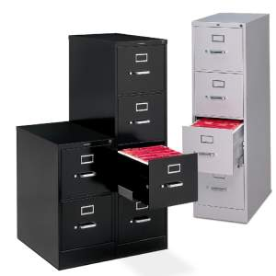
Operating system
Part IX: IO Devices
--- Use HDD as instance to understand the mapping between file and blocks
--- Trend: Attempt to manage devices uniformly

Slide 2
Goals
Know the basic concepts related to IO
Types of devices
General framework to connect devices with computers
How to control the devices
Know the techniques related to Hard Disk
So as to provide the basis for file system

Slide 3

File concept [We all know “file”, but what is it essentially?]
Anything you are interested in and want to store permanently could be a “file”!
Long-term Information Storage
Must store large amounts of data
Information stored must survive the termination of the process using it
Multiple processes must be able to access the information concurrently
Each file is a named collection of data stored in a permanent device

Slide 4

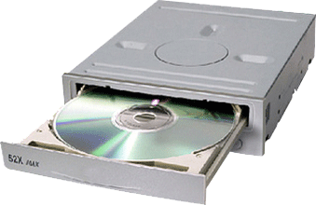
We need store file permanently in secondary storage media, like Hard Disk
Processes
User’s (process’s) view of files
File System Calls
File 1
File 2
?
Mapping 2 – from file to Hdisk
Disk Driver
Disk Controller
Disk
Notes:
[2012-10-26]给研究生讲到这里的时候, 理得更顺了:
文件到硬盘空间的映射有两个子映射: File space → addressed Blocks, 和 Block → addressed sectors. 他们就跟文件到内存的基于页面的映射相类似: 文件的一堆0或1, 按照一定的size分割成固定大小的block, 然后每一个block又分割成更小的sector. 他们的映射就是查找是否有可用的bock/sector存放而已 – 当然, 需要有数据结构支持
那些数据结构也跟内存管理类似: 显然要有整个空间的管理结构, 以及每个文件/block映射到(block空间)/(sector集合)的映射表.
那么剩下的就是: 那些数据结构以及相应操作都存在哪里? 操作系统将之分成了两步骤: 专门的文件系统对文件进行管理 – 它们的组织结构以及文件到Blocks的映射; 驱动程序保存了硬盘的Sector空间以及Block到sector 的映射表.
处理流程如下:
当创建一个新文件时, 意味着在文件系统维护的数据结构中添加一个文件实例(属性, 目录等)
当写入数据时,意味着修改的内容从内存的页面保存到相应的Sector集合, 并且每一个页面要保存时, 也就意味着对应的Block中的0/1写入实际的Sector集合. 分成两步:
查找文件系统维护的Block表, 按照给定数据寻求可用的Blocks, 也就意味着对应每一Block的Sector也确定了;
Block写入Sector, 即将Block中的0/1集合分割成固定大小的小段, 然后交由磁盘的驱动程序找到相应的Sector写入即可
其他的操作, 如修改, 删除, 可以类似理解.
从上述描述知, 硬盘就是一个小的“电脑系统”: 电子部件对应电脑的CPU – 能够理解和执行一套指令以控制读写和数据的传输; 而驱动程序的作用就是提供给文件系统接口: 驱动程序显然是程序的集合(类似操作系统), 接收传来的指令和数据(往往是一个或多个Block)将写入到相应的Sector.

Slide 5
I reorganize the IO + File system
Because Mapping 2 and Mapping 1 (with HDisk as instance) could be understood following similar idea
They both
From logic program/file to linear addressed space
Allocation and Address Translation
Indexing data structure (Tree)
Some data structures are also needed and kept in MM to locate those programs
I suggest that you’d better remember this and follow this to understand the rest parts!

Slide 6
Basic IO
General structure to connect devices –
Abstraction/Interface in OS to communicate with the diverse devices
IO devices - Categories of devices
IO operations
Connect all together & structure of IO module in OS
Communication types between CPU and IO devices
Taking (Magnetic) Disk for instance
So-called “linear address sector space”
Organize sectors into partitions, and so-called “linear addressed block space”
Optical disk is similar

Slide 7
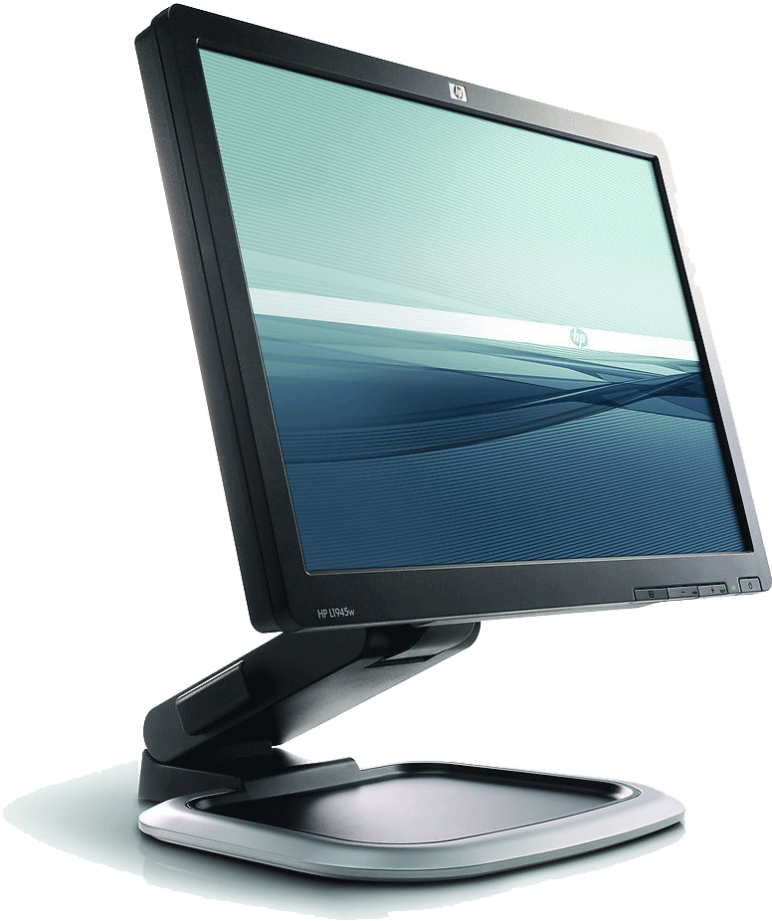
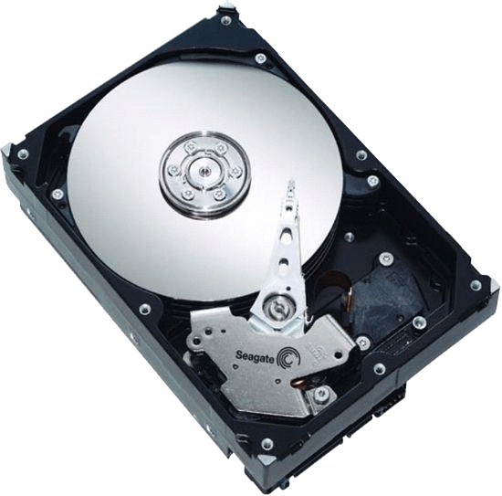



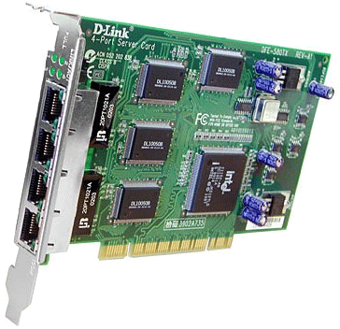
We have many different devices

Slide 8
Three Device Types
Most operating system have three device types:
Character devices [字符设备]
Character devices are read and written directly without buffering
Used for serial-line types of devices (e.g. USB port)
Block devices: [块设备]
Block devices can only be written to and read from in multiples of the block size, typically 512 or 1024 bytes
Used for mass-storage (E.g. hard disks, tapes and CDROM)
Network devices
Network devices are accessed via the socket interface
Used for network interfaces (E.g. Ethernet card)
PPTs from others\paul.rutgers.edu_cs519_S02\IO-File.ppt
Notes:
Block devices are accessed via the buffer cache and may be randomly accessed, that is to say, any block can be read or written no matter where it is on the device.

Slide 9
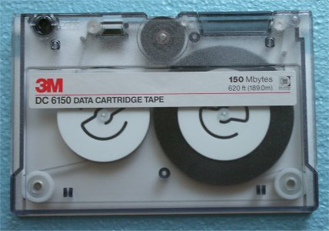
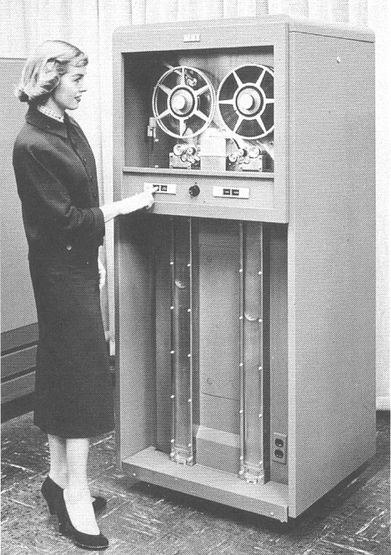
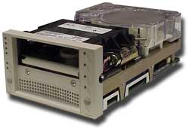
Sequential Access Devices
Sequential Access = In order to access specific information, the device must sequentially pass through all preceding information
9 Track Tape (Reel to Reel [逐卷地])
Cartridge Tapes
PPTs\Part XII\Part XII magnetic media].ppt

Slide 10
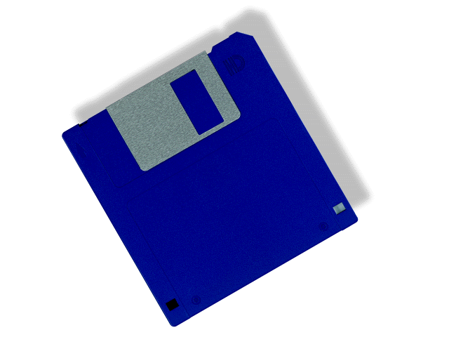
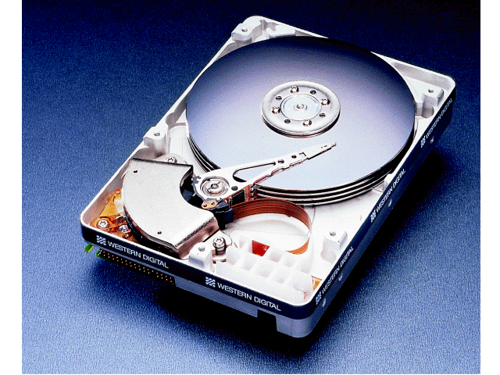
Direct Access Devices
Direct Access = The specific information is accessed directly
Examples
floppy disk drives
hard disk drives
cartridge disk drives
CD ROM and DVD drives
PPTs\Part XII\Part XII magnetic media].ppt

Slide 11
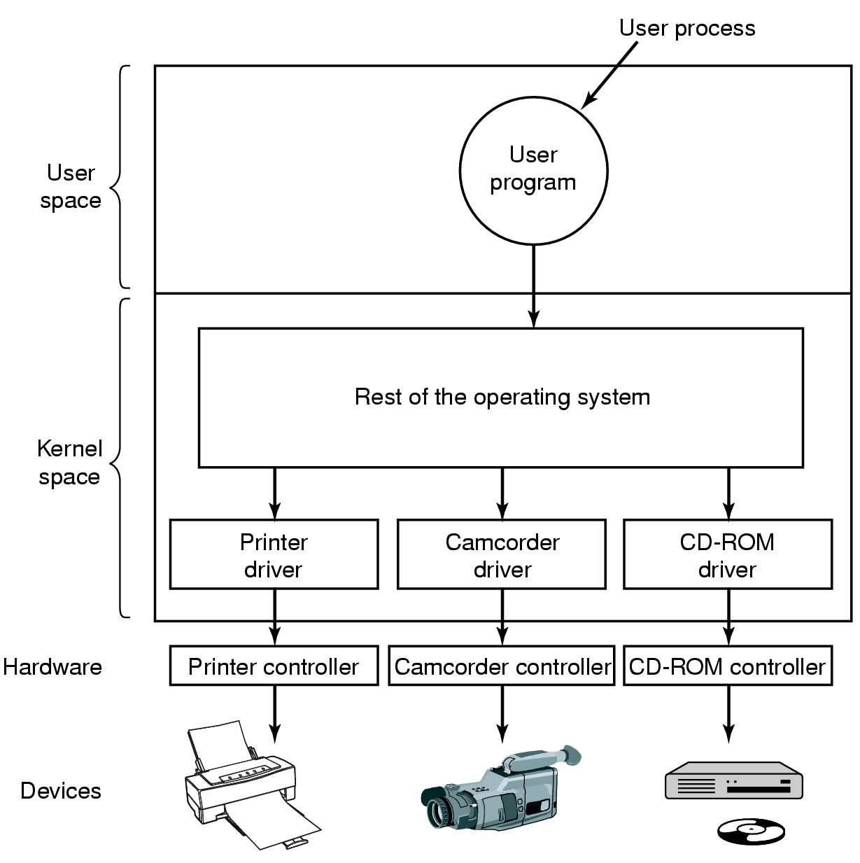
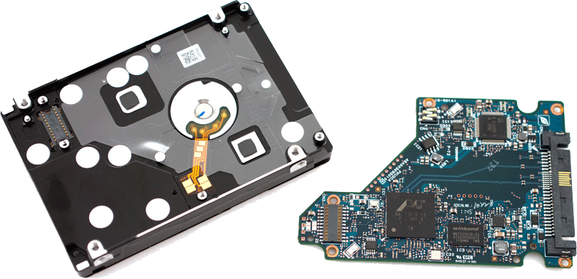
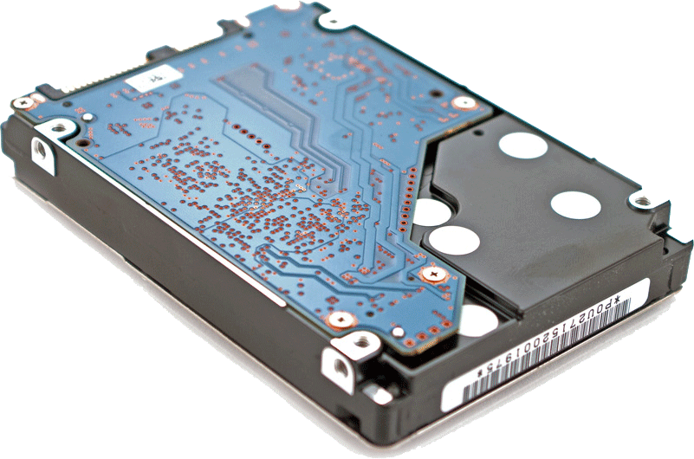
They share similar connection architecture

Slide 12
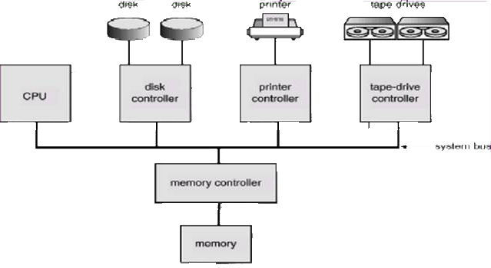
MM is also connected with controller
Buses –
Data, Instruction, Address

Slide 13
Device controller [控制器]
Device controller: hardware that connects the device to the computer.
continuously monitors and controls the operation of the device.
provides an interface to the computer.
Controller's tasks
Control the physical operation of the device
Convert serial bit stream to block of bytes
Perform error correction as necessary
Since several devices need to be connected to a computer, they are connected trough the bus.
PPTs from others\cms.dt.uh.edu\chap04.ppt

Slide 14
Device Controller Interface
busy done
0 0 idle
0 1 finished
1 0 working
1 1 (undefined)
. . .
busy
done
Error code
. . .
Command
Status
Data 0
Data 1
Logic
Just like a special CPU chip: it could understand the instruction (with parameters), and drive the devices
Data n-1
PPTs from others\cms.dt.uh.edu\chap04.ppt

Slide 15
Device Controller Interface
busy done
0 0 idle
0 1 finished
1 0 working
1 1 (undefined)
. . .
busy
done
Error code
. . .
Command
Status
Data 0
Data 1
Logic
Data n-1
PPTs from others\cms.dt.uh.edu\chap04.ppt

Slide 16
The device communicates with the computer via a communication point called a port. [端口号]
Exchange data with CPU via registers
By writing into these registers
OS can command the device to deliver or accept data, to switch the device on or off
By reading from the registers
OS can learn the status of the device
PPTs from others\epcc.sjtu.edu.cn_~os\OS16.ppt

Slide 17
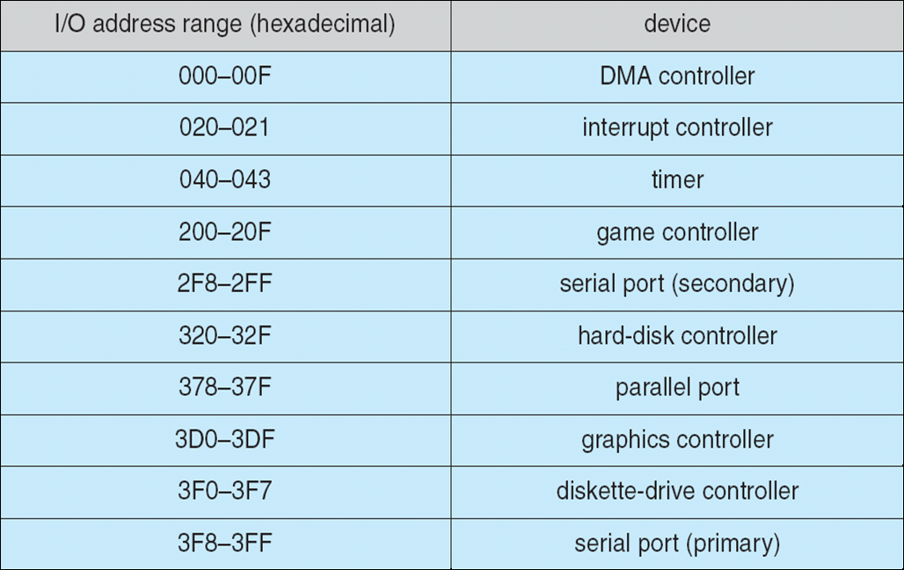
Device I/O Port Locations on PCs (partial)
PPTs.2012\PPTs from others\www.cs.bilkent.edu.tr_~korpe_courses_cs342spring2010\lecture13_io.ppt

Slide 18
We also need device Drivers [驱动程序]
The software that talks to the device controllers
Device specific
Tailored to individual device characteristics
Written by device manufacturers
Part of the OS Kernel
Know about the details of the devices
Disk driver knows about sectors, tracks, cylinders, heads, arm motions, motor drives
Mouse driver knows about button pressed
PPTs from others\epcc.sjtu.edu.cn_~os\OS17.ppt

Slide 19
User/OS method interface
The same interface is used to access devices (like disks and network lines) and more abstract resources like files
4 main methods:
open(), close(), read(), write()
Semantics depend on the type of the device (block, char, net)
These methods are system calls because they are the methods the OS provides to all processes.
PPTs from others\paul.rutgers.edu_cs519_S02\IO-File.ppt

Slide 20
The Device Driver Interface
…
write(…);
…
Device Interface
Terminal
Driver
Printer
Driver
Disk
Driver
Terminal
Controller
Printer
Controller
Disk
Controller
PPTs from others\cms.dt.uh.edu\chap05.ppt
Notes:
Zh 4-19

Slide 21
Now we know how to connect Hdisk
Processes
User’s (process’s) view of files
File System Calls
File 1
File 2
?
What does the Hdisk space look like?
Disk Driver
Disk Controller
Disk
Notes:
[2012-10-26]给研究生讲到这里的时候, 理得更顺了:
文件到硬盘空间的映射有两个子映射: File space → addressed Blocks, 和 Block → addressed sectors. 他们就跟文件到内存的基于页面的映射相类似: 文件的一堆0或1, 按照一定的size分割成固定大小的block, 然后每一个block又分割成更小的sector. 他们的映射就是查找是否有可用的bock/sector存放而已 – 当然, 需要有数据结构支持
那些数据结构也跟内存管理类似: 显然要有整个空间的管理结构, 以及每个文件/block映射到(block空间)/(sector集合)的映射表.
那么剩下的就是: 那些数据结构以及相应操作都存在哪里? 操作系统将之分成了两步骤: 专门的文件系统对文件进行管理 – 它们的组织结构以及文件到Blocks的映射; 驱动程序保存了硬盘的Sector空间以及Block到sector 的映射表.
处理流程如下:
当创建一个新文件时, 意味着在文件系统维护的数据结构中添加一个文件实例(属性, 目录等)
当写入数据时,意味着修改的内容从内存的页面保存到相应的Sector集合, 并且每一个页面要保存时, 也就意味着对应的Block中的0/1写入实际的Sector集合. 分成两步:
查找文件系统维护的Block表, 按照给定数据寻求可用的Blocks, 也就意味着对应每一Block的Sector也确定了;
Block写入Sector, 即将Block中的0/1集合分割成固定大小的小段, 然后交由磁盘的驱动程序找到相应的Sector写入即可
其他的操作, 如修改, 删除, 可以类似理解.
从上述描述知, 硬盘就是一个小的“电脑系统”: 电子部件对应电脑的CPU – 能够理解和执行一套指令以控制读写和数据的传输; 而驱动程序的作用就是提供给文件系统接口: 驱动程序显然是程序的集合(类似操作系统), 接收传来的指令和数据(往往是一个或多个Block)将写入到相应的Sector.

Slide 22
Basic IO
General structure to connect devices –
Abstraction/Interface in OS to communicate with the diverse devices
IO devices - Categories of devices
IO operations
Connect all together & structure of IO module in OS
Communication types between CPU and IO devices
Taking (Magnetic) Disk for instance
So-called “linear address sector space”
Organize sectors into partitions, and so-called “linear addressed block space”
Optical disk is similar

Slide 23
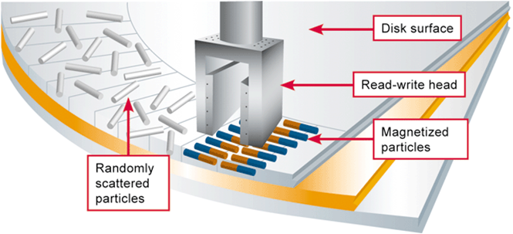
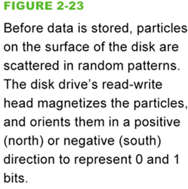
The basis of magnetic storage media
Magnetic storage stores data by magnetizing microscopic particles on the disk or tape surface
magnetism [ˈmæɡnitizəm]
n. 磁(性), 磁力[学]; 磁力现象

Slide 24
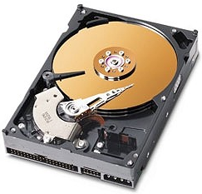
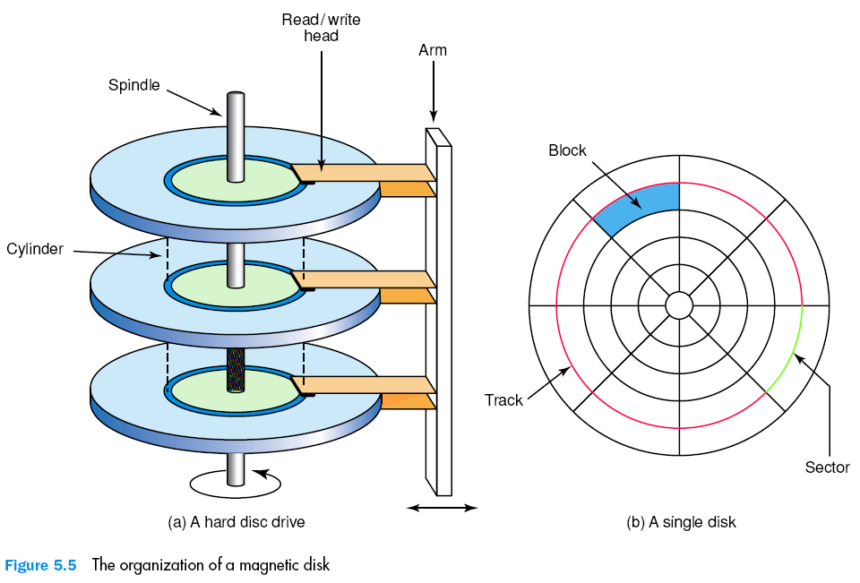
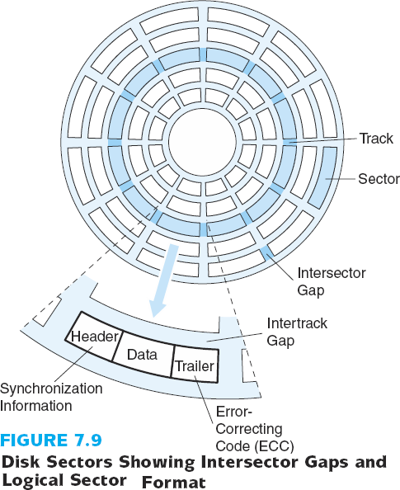
Magnetic Disk
00.Computer & Related\PPTs.2009\Part II Computer architecture.pptx
Computer_Science_Illuminated__N.Dale_J.Lewis.2002
P156
Spindle: 轴
Cylinder[ˈsilində]: 圆柱
Notes:
Zh 4-23

Slide 25
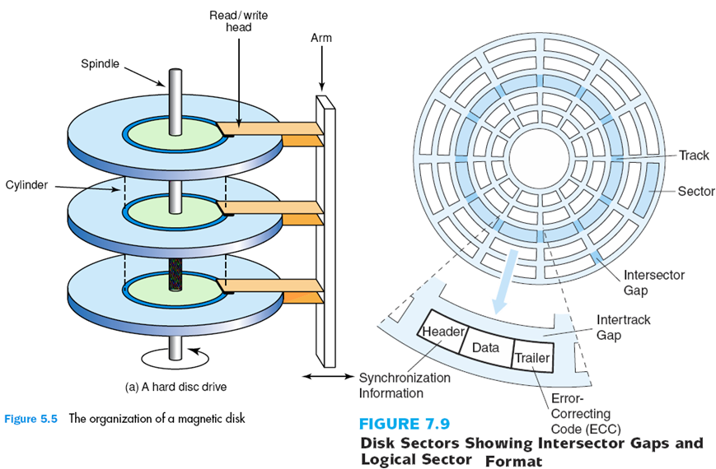
Cont’
Sectors are organized by the predefined rules, like the inner most one is numbered 0 sector.
Numbering for the sectors
(cylinder #, head #, sector #)
The sector number is recorded in the header of each sector.
Notes:
Special data structure for each sector: header – data – trailer
Header and Trailer contains information used by disk controller, such as a sector number and an Error-correcting code (ECC)
When the controller writes a sector of data, ECC is updated with a value calculated from all the bytes in the data area
When the sector is read, ECC is recalculated and is compared with the stored value → verify the data is correct

Slide 26
Mapping files to blocks and sectors?
Processes
User’s (process’s) view of files
File System Calls
File 1
File 2
?
Map files to sectors?
Disk Driver
Disk Controller
Cylinders,
Header/tracks,
Sectors
0
1
2
3
4
5
Sector space
(like storage
units in MM)
Disk
6
7
8
9
10
11
Notes:
[2012-10-26]给研究生讲到这里的时候, 理得更顺了:
文件到硬盘空间的映射有两个子映射: File space → addressed Blocks, 和 Block → addressed sectors. 他们就跟文件到内存的基于页面的映射相类似: 文件的一堆0或1, 按照一定的size分割成固定大小的block, 然后每一个block又分割成更小的sector. 他们的映射就是查找是否有可用的bock/sector存放而已 – 当然, 需要有数据结构支持
那些数据结构也跟内存管理类似: 显然要有整个空间的管理结构, 以及每个文件/block映射到(block空间)/(sector集合)的映射表.
那么剩下的就是: 那些数据结构以及相应操作都存在哪里? 操作系统将之分成了两步骤: 专门的文件系统对文件进行管理 – 它们的组织结构以及文件到Blocks的映射; 驱动程序保存了硬盘的Sector空间以及Block到sector 的映射表.
处理流程如下:
当创建一个新文件时, 意味着在文件系统维护的数据结构中添加一个文件实例(属性, 目录等)
当写入数据时,意味着修改的内容从内存的页面保存到相应的Sector集合, 并且每一个页面要保存时, 也就意味着对应的Block中的0/1写入实际的Sector集合. 分成两步:
查找文件系统维护的Block表, 按照给定数据寻求可用的Blocks, 也就意味着对应每一Block的Sector也确定了;
Block写入Sector, 即将Block中的0/1集合分割成固定大小的小段, 然后交由磁盘的驱动程序找到相应的Sector写入即可
其他的操作, 如修改, 删除, 可以类似理解.
从上述描述知, 硬盘就是一个小的“电脑系统”: 电子部件对应电脑的CPU – 能够理解和执行一套指令以控制读写和数据的传输; 而驱动程序的作用就是提供给文件系统接口: 驱动程序显然是程序的集合(类似操作系统), 接收传来的指令和数据(往往是一个或多个Block)将写入到相应的Sector.

Slide 27
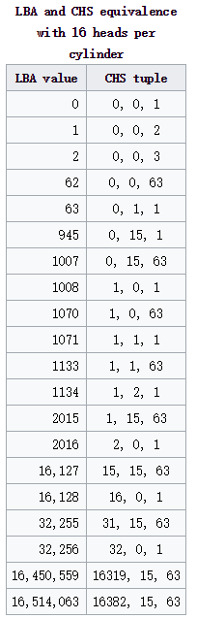
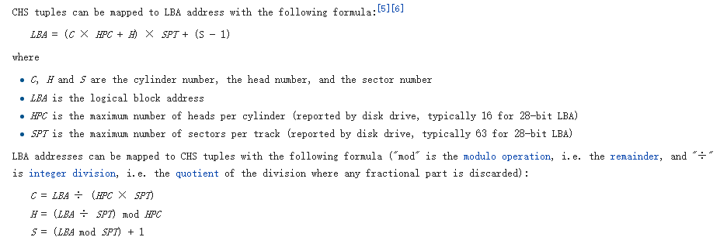
LBA now for CHS
https://en.wikipedia.org/wiki/Logical_block_addressing
Logical block addressing
Logical block addressing (LBA) is a common scheme used for specifying the location of blocks of data stored on computer storage devices, generally secondary storage systems such as hard disk drives.

Slide 28
Basic IO
General structure to connect devices –
Abstraction/Interface in OS to communicate with the diverse devices
IO devices - Categories of devices
IO operations
Connect all together & structure of IO module in OS
Communication types between CPU and IO devices
Taking (Magnetic) Disk for instance
So-called “linear address sector space”
Like the storage units in MM
Organize sectors into partitions, and so-called “linear addressed block space”
Optical disk is similar

Slide 29
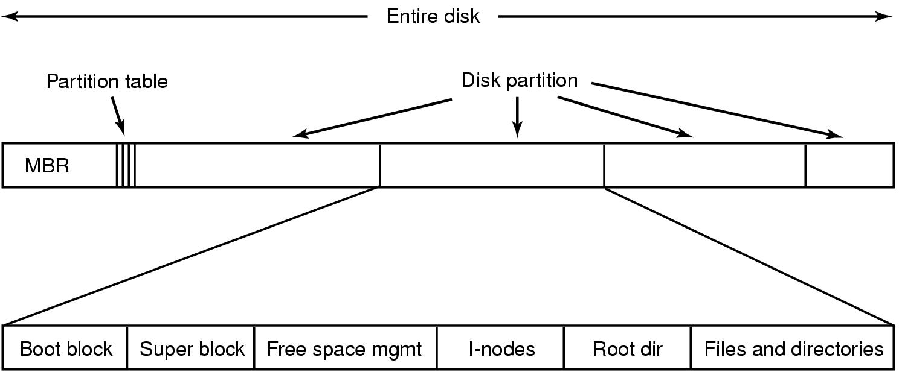


Some special sectors in HD
0
1
2
3
# of sectors
After LLF (low level formatting, which has usually been carried out by HD manufacturer like ), by default your disk is a collection of numbered sectors
Divide a disk into sectors that the controller can read and write (write C.H.S into header, etc.)
Sector 0 is called the Master Boot Record (MBR :主引导记录) which is used when booting the computer
Some information about the manufacturing – date, size …
At the end, the table of partitions – “logic disks” in the HD
Notes:
Disk Formatting [磁盘格式化], is also called Low-level formatting, or physical formatting. Divide a disk into sectors that the controller can read and write

Slide 30
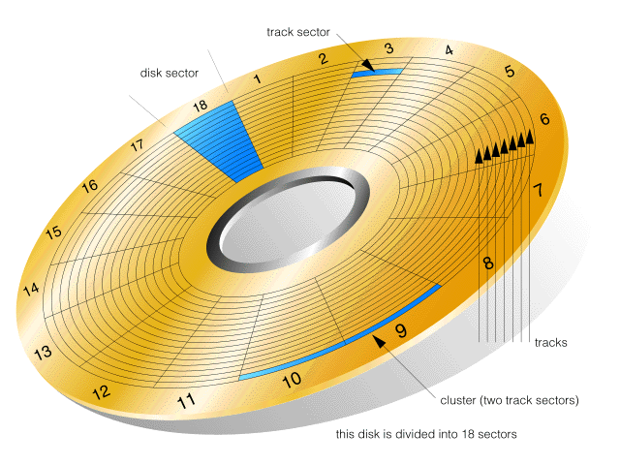
Sector is too small!
Several sectors are combined to create clusters or blocks
cluster (Windows and Macs) or block (UNIX) = The number of sectors which is allocated on the disk each time a file needs space on the disk.
Windows 95 (later versions) and Windows 98 using FAT32
1 cluster = 8 sectors (4K bytes)
Recognizes disk drives up to 2 terabytes (2 trillion bytes)
NTFS?
PPTs\Part XII\Part XII magnetic media].ppt

Slide 31
Disk Partition [磁盘分区]
To use a disk to hold files, OS still needs to record its own data structures on the disk
Partition the disk into one or more groups of cylinders
Each partition can be treated as a separate disk
Logical formatting or “making a file system”
Store the initial file-system data structure onto the disk…
Maps of free and allocated space (FAT or i-node, discussed later)
Initial empty directory
We’ll learn FAT, i-node, NTFS – the way to organize files - later
In fact this is like organize storage units of MM into frames

Slide 32
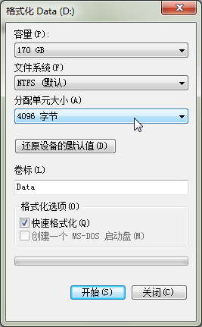
First, organize sectors in a partition into blocks
The popular size in Windows now is 4KB (4096 bytes)
Which means a block usually contains 8 sectors
You can set the File System you want to use for this partition
NTFS (NT File System) here
You can also label it
Volume index here “Data”

Slide 33
Partitions in HD
MBR
Do you remember “What does OS do after turning-on but before your OS?”
After POST, BIOS (CMOS) will check the HDs to locate the OS(s) by reading the MBR of each HD
The partition table in MBR contains all the location information (starting CHS) of partitions
Each partition is further organized to contain the files based on a complex data structure called file system
If in primary partition, bootstrap loader reads necessary OS’s codes with help of file system into main memory, and CPU executes those programs – you can use OS now

Slide 34
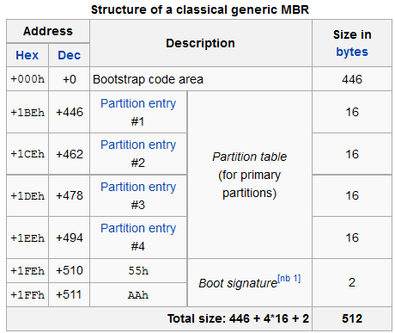
MBR – for demonstration
http://en.wikipedia.org/wiki/Master_boot_record
16 bytes for “partition entry” are used to indicate the 1st sector number of the corresponding partition

Slide 35
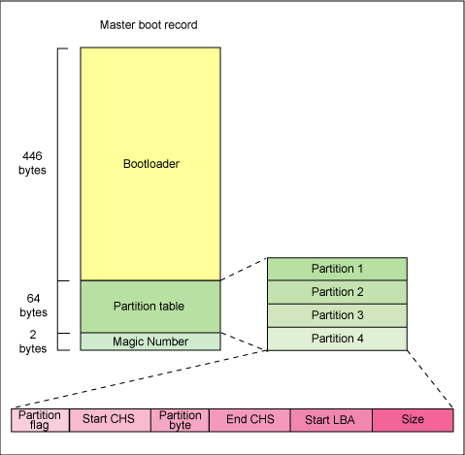
http://www.ibm.com/developerworks/library/l-linuxboot/
Notes:
http://www.ibm.com/developerworks/library/l-linuxboot/
[2015年3月19日21:01:45 逸夫西楼811]

Slide 36
Disk Space Organization
Disk can be partitioned
Each partition can have a different OS and/or different file system
One partition can be swap space for main memory
Each partition has
Block 0
Block 1
Block 2
Block K

Slide 37
Organize sectors into blocks?
Given a partition whose starting sector is 1024, and the size of a block is defined as 4KB, could you determine the sectors for a block 7 in this partition?
Since 4 KB = 8*512B = 8 sectors, the 1st sector of the block 7 should be: 7*8 = 56th sector
So the 1st sector of block 7 in this partition is just: 1024 + 56 = 1080 sector
If you want to store a file of 17 KB, it’s easy to know we need ┌17/4┐= 5 blocks.
Of course we need record some information so as to retrieve the blocks used to store your file – some data structure!
We’ll learn those data structures later
Notes:
[2017年4月11日20:48:07] Kao, 讲课时注意到有误! 尴尬~~

Slide 38
Now we have linear addressed block space for files
Processes
User’s (process’s) view of files
?
File System Calls
File 1
File 2
Manage files based on blocks? – Need data structures
0
1
2
3
4
5
file system’s view of the disk
Disk Driver
Disk Controller
Cylinders,
Header/tracks,
Sectors
0
1
2
3
4
5
Sector space
(like storage
units in MM)
Disk
6
7
8
9
10
11
Notes:
[2012-10-26]给研究生讲到这里的时候, 理得更顺了:
文件到硬盘空间的映射有两个子映射: File space → addressed Blocks, 和 Block → addressed sectors. 他们就跟文件到内存的基于页面的映射相类似: 文件的一堆0或1, 按照一定的size分割成固定大小的block, 然后每一个block又分割成更小的sector. 他们的映射就是查找是否有可用的bock/sector存放而已 – 当然, 需要有数据结构支持
那些数据结构也跟内存管理类似: 显然要有整个空间的管理结构, 以及每个文件/block映射到(block空间)/(sector集合)的映射表.
那么剩下的就是: 那些数据结构以及相应操作都存在哪里? 操作系统将之分成了两步骤: 专门的文件系统对文件进行管理 – 它们的组织结构以及文件到Blocks的映射; 驱动程序保存了硬盘的Sector空间以及Block到sector 的映射表.
处理流程如下:
当创建一个新文件时, 意味着在文件系统维护的数据结构中添加一个文件实例(属性, 目录等)
当写入数据时,意味着修改的内容从内存的页面保存到相应的Sector集合, 并且每一个页面要保存时, 也就意味着对应的Block中的0/1写入实际的Sector集合. 分成两步:
查找文件系统维护的Block表, 按照给定数据寻求可用的Blocks, 也就意味着对应每一Block的Sector也确定了;
Block写入Sector, 即将Block中的0/1集合分割成固定大小的小段, 然后交由磁盘的驱动程序找到相应的Sector写入即可
其他的操作, 如修改, 删除, 可以类似理解.
从上述描述知, 硬盘就是一个小的“电脑系统”: 电子部件对应电脑的CPU – 能够理解和执行一套指令以控制读写和数据的传输; 而驱动程序的作用就是提供给文件系统接口: 驱动程序显然是程序的集合(类似操作系统), 接收传来的指令和数据(往往是一个或多个Block)将写入到相应的Sector.

Slide 39
Those data structures are maintained by File system
We just think and use
files when we
want to store
something
(logical storage component)
Users
Applications/Processes
file
file
file
file
file
file
Operating System and its
File System component
floppy disk
Hard Disk
Mobile
disk
USB Disk
CD
tape

Slide 40
I/O System – connect devices together
user process
user process
user process
file system
OS
I/O system
device driver
device controller
disk
PPTs.2012\PPTs from others\pages.cs.wisc.edu_~remzi_Classes_537_Fall2005\lecture19.ppt

Slide 41
Basic IO
General structure to connect devices –
Abstraction/Interface in OS to communicate with the diverse devices
IO devices - Categories of devices
IO operations
Connect all together & structure of IO module in OS
Communication types between CPU and IO devices
Taking (Magnetic) Disk for instance
So-called “linear address sector space”
Organize sectors into partitions, and so-called “linear addressed block space”
Optical disk is similar

Slide 42
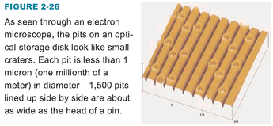
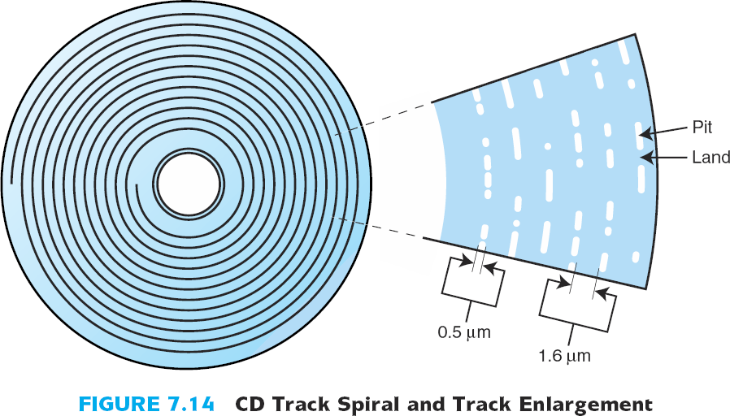
CD (Compact Disk)
crater [ˈkreitə]
n.弹坑; 陨石坑
pit n.坑
00.Computer & Related\PPTs.2009\Part II Computer architecture.pptx

Slide 43
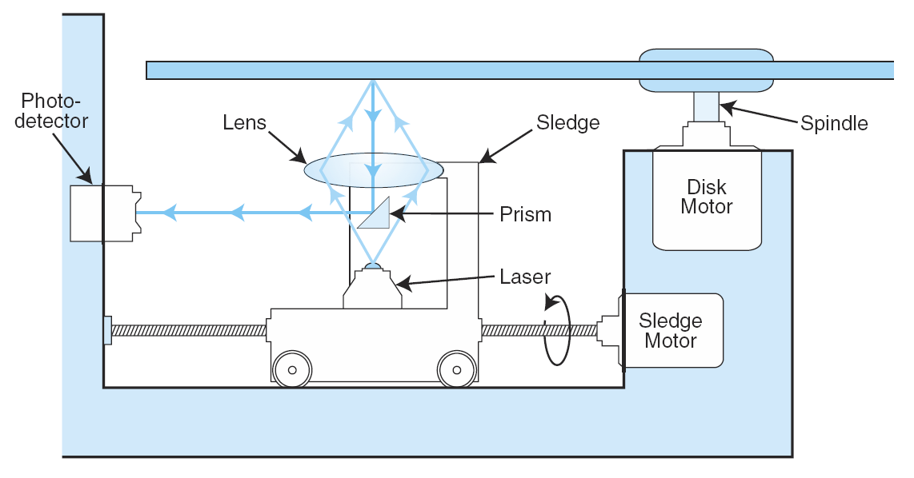
The Internals of a CD-ROM Drive
Your responsibility to know others.
00.Computer & Related\PPTs.2009\Part II Computer architecture.pptx
sledge: 雪橇, 雪车
prism: (几何)棱柱（体)，角柱（体）

